Slide 1
Fabulous!
Fast! Fun!
Playground Maps
Contact: Michael Nazemetz
Rotary Club Portland Sunrise

Slide 2
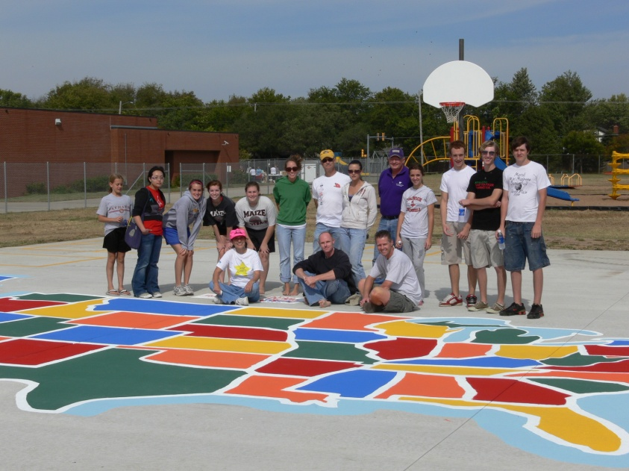
Fabulous Community Service
Paint a map of the United States
on an Elementary School Playground

Slide 3
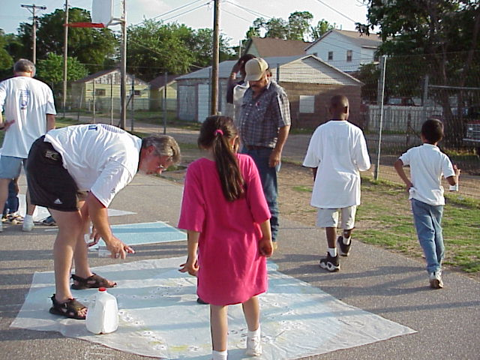
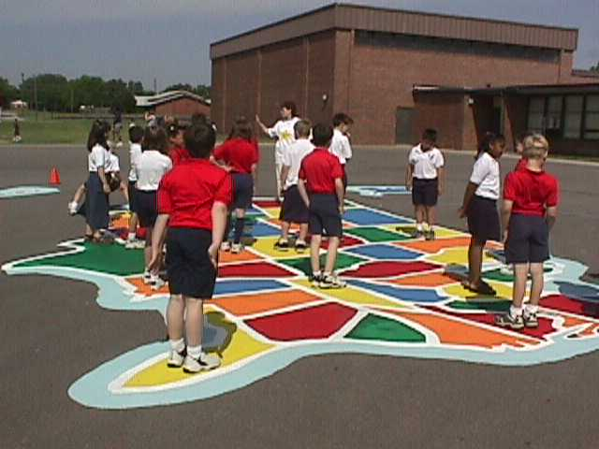
Fabulous Community Service
Teaching aid
Social Studies, Math,
Geography, Science
CD of teaching ideas
Neighborhood
Families
Fun

Slide 4
Fabulous Community Service
Mark longitude and latitude lines.
Mark time change boundaries.
Mark state capitals.
Label interstate highways.
Label major rivers.
Color code rivers to show which flow into each other.
Label famous places, such as Mount Rushmore, the Grand Canyon, and battlefields.
Label National Park sites. (And if there’s one near you, take a field trip!)
Label historical boundaries, such as the original 13 colonies, states that signed the Constitution, areas of the Louisiana Purchase, gold rush areas, northern states, southern states.
Mark the dates on which each state entered the Union.
Trace the migrations of North America’s earliest settlers.
Label sites of major Indian cultures.
Mark the number of U.S. senators and representatives for each state.
Label each state’s electoral votes.
Create a distance scale.
Calculate the number of miles from your city to places students would like to visit.
Trace the jet stream.
Label rainfall and temperatures on a daily or weekly basis for selected cities.
Trace bird migration patterns.

Slide 5
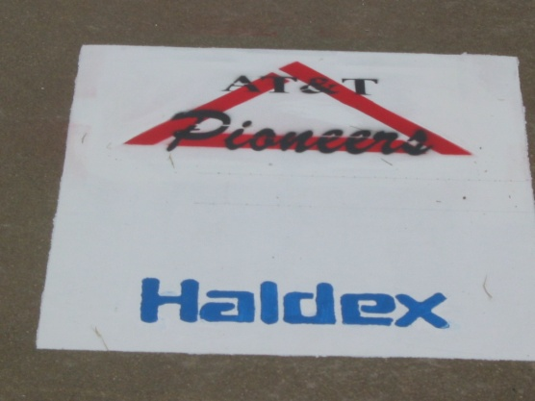
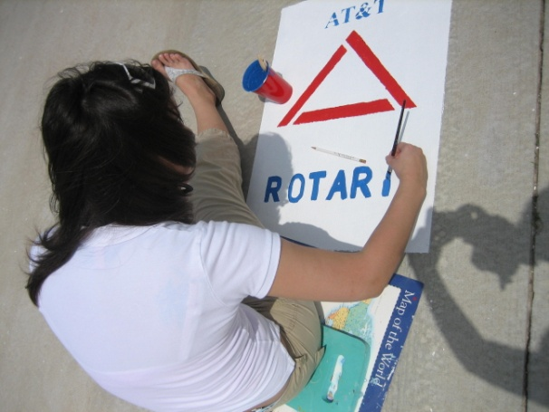
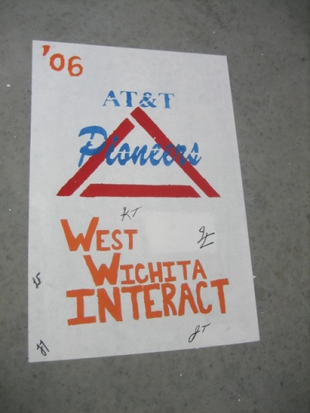
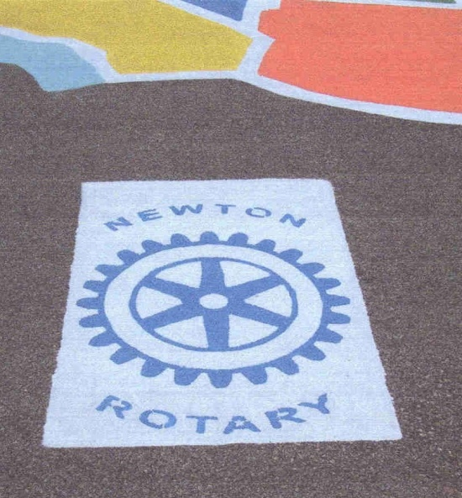
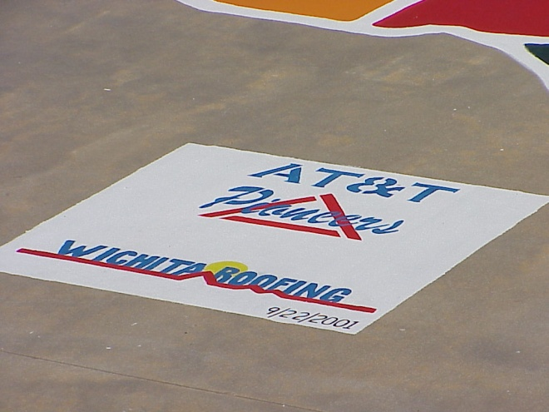
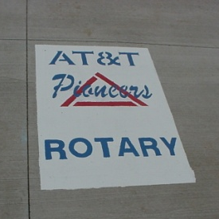
Fabulous Public Relations
On the Map Itself

Slide 6
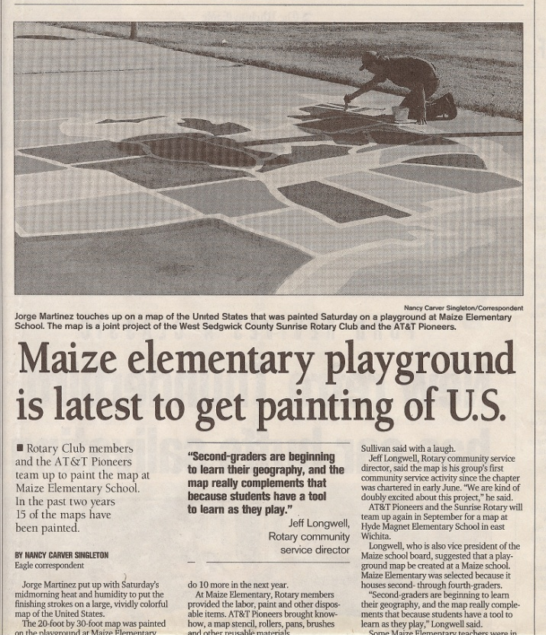

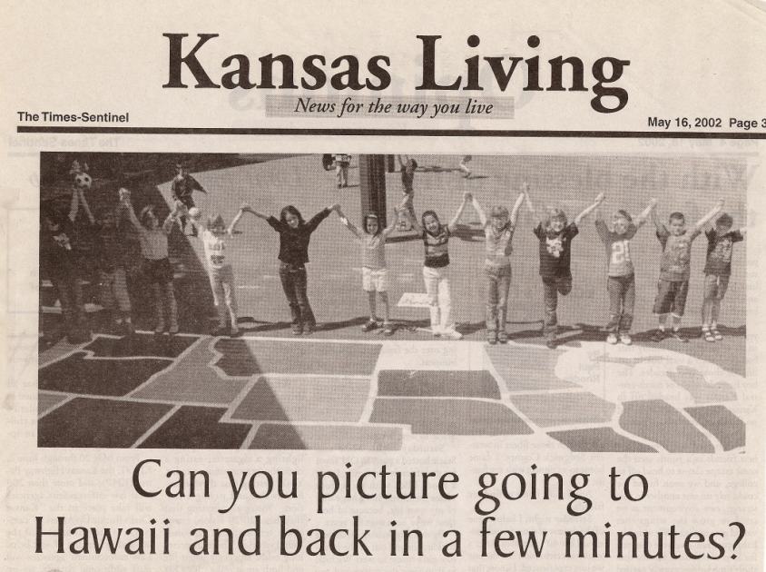
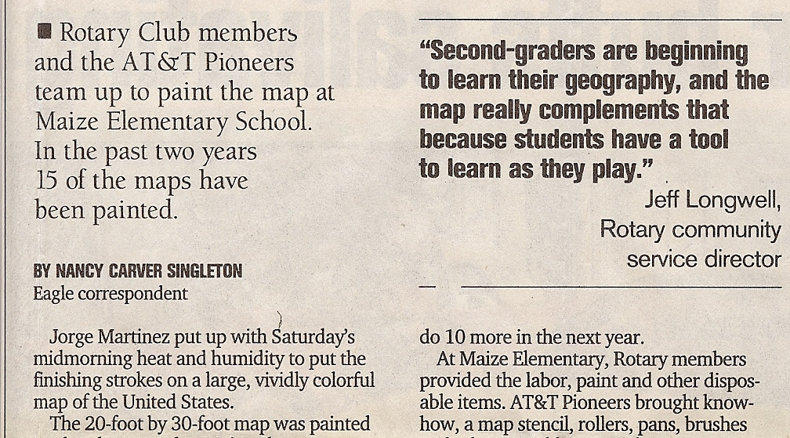
Fabulous Public Relations
In the Press

Slide 7
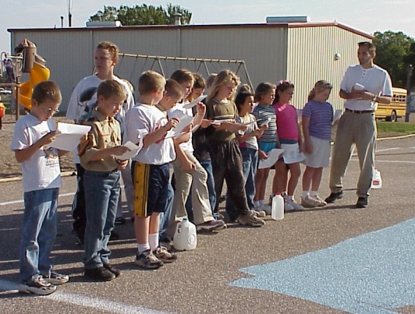
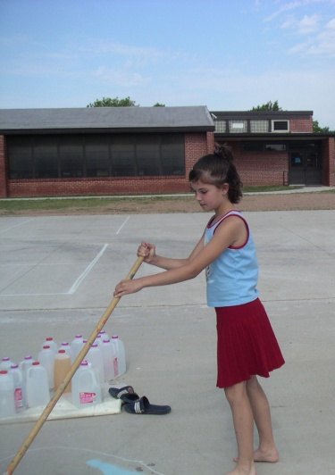
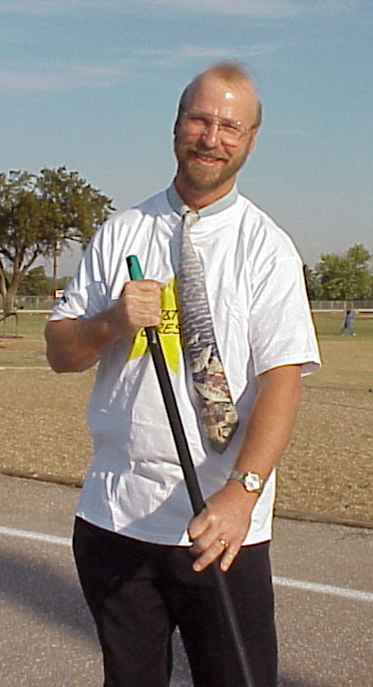
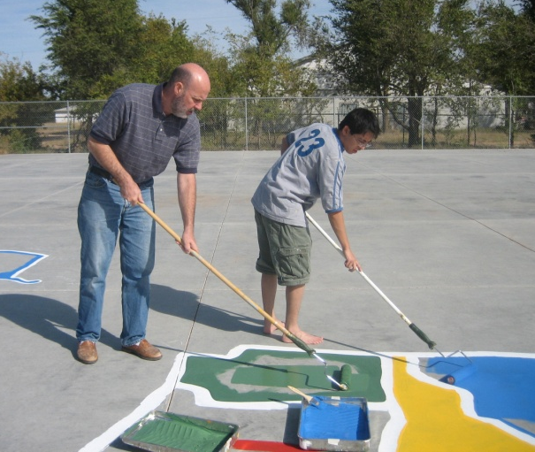
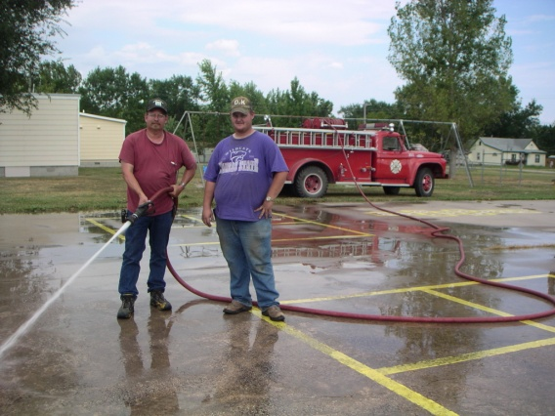
Fabulous Membership
Recruitment – Working with Others
Who Else?
Potential Members
School Admin
Other Rotary
Clubs
Interact
Parents
Other Service Clubs
Teachers

Slide 8
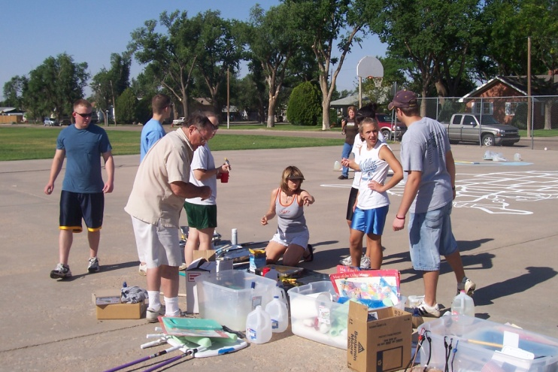
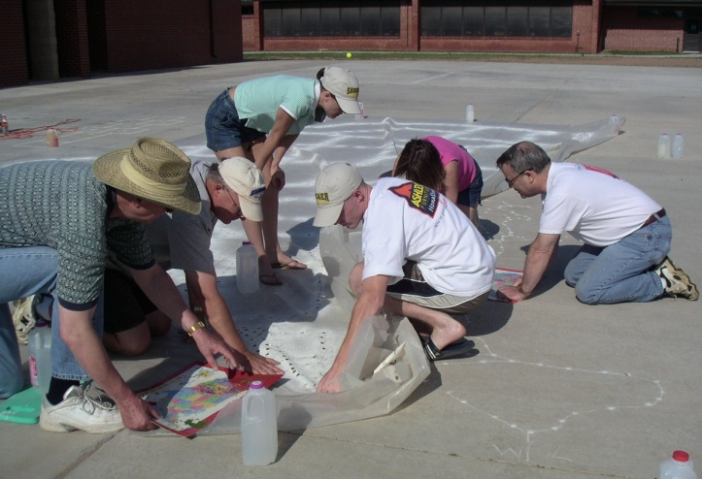
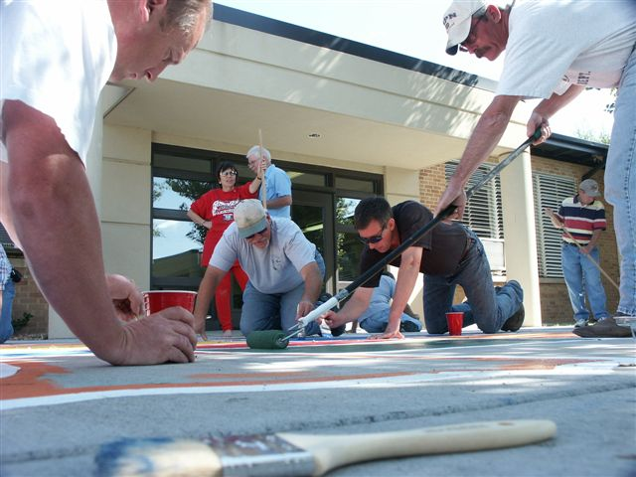
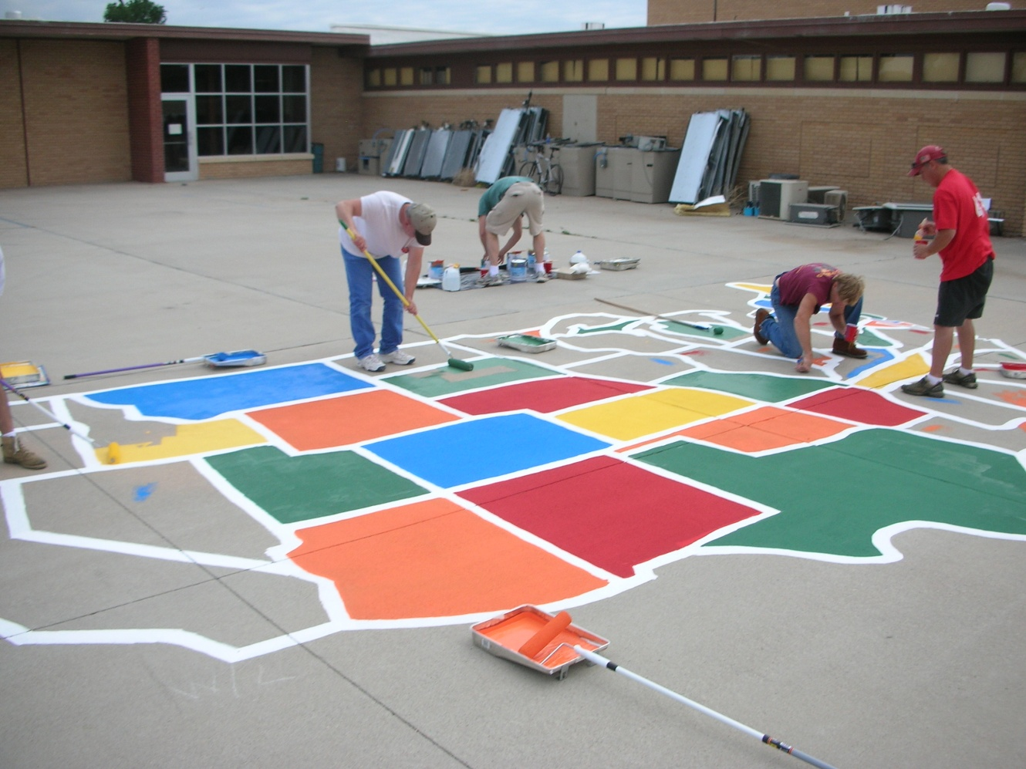
Fabulous Membership
Adult
Family
Retention = Involvement
Potential Members
New Members
Interact
Rotaract

Slide 9
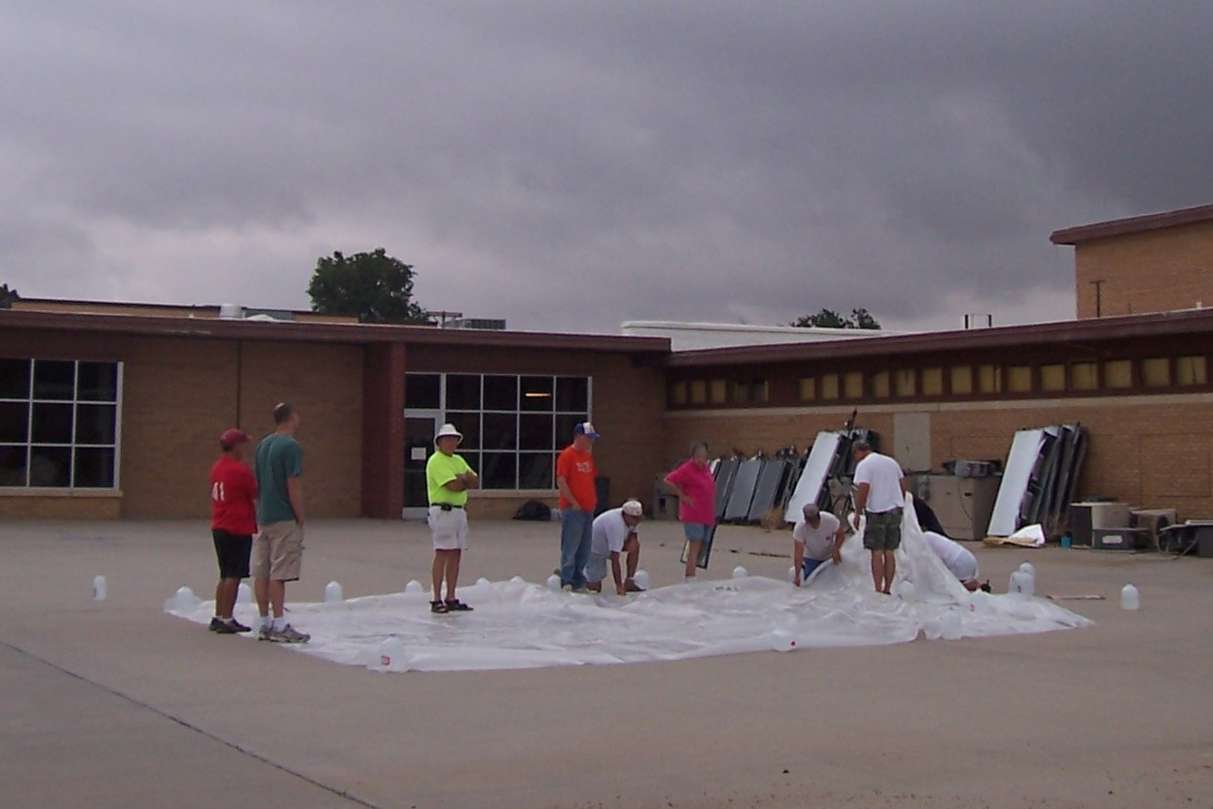
Fast
1. Lay out the stencil.

Slide 10
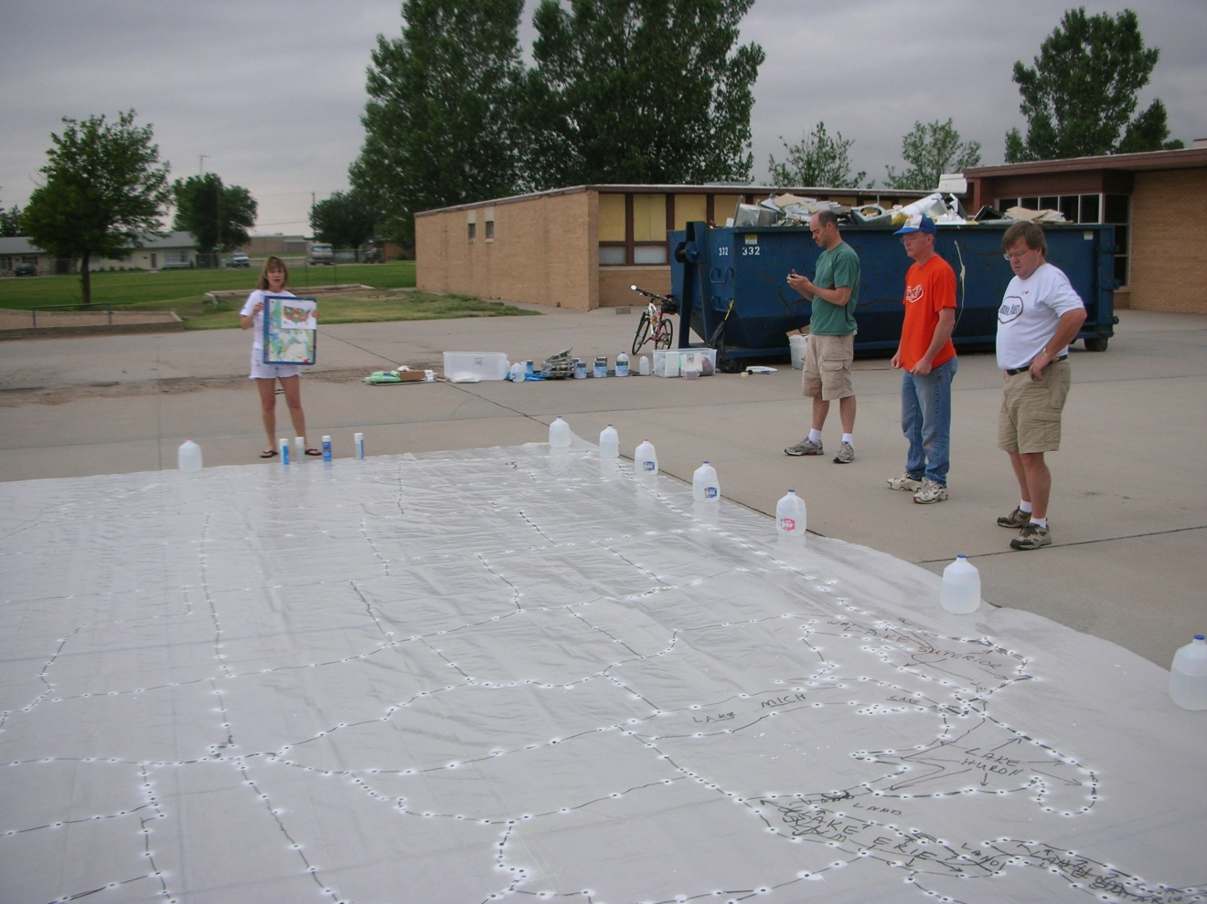
Fast
2. Spray the dots.

Slide 11
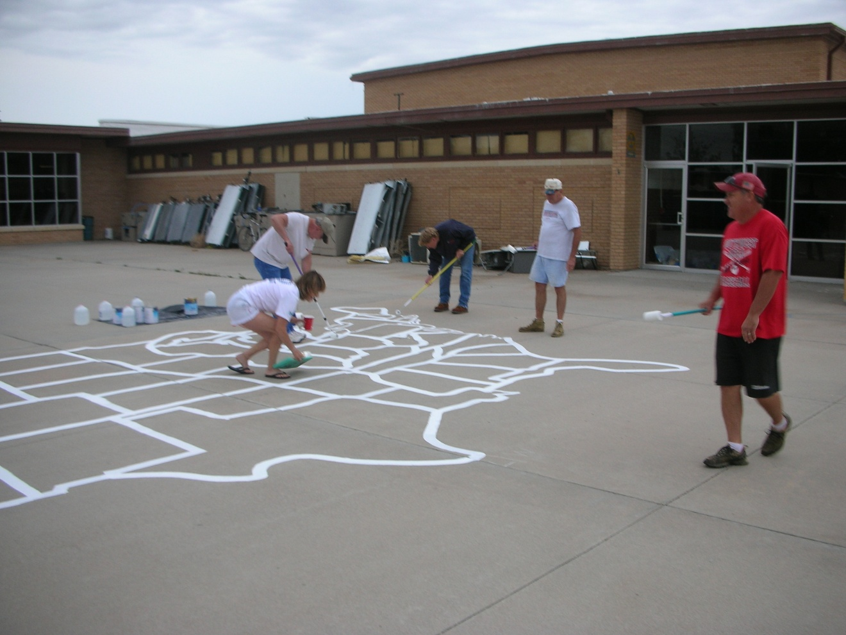
Fast
3. Outline the states.

Slide 12
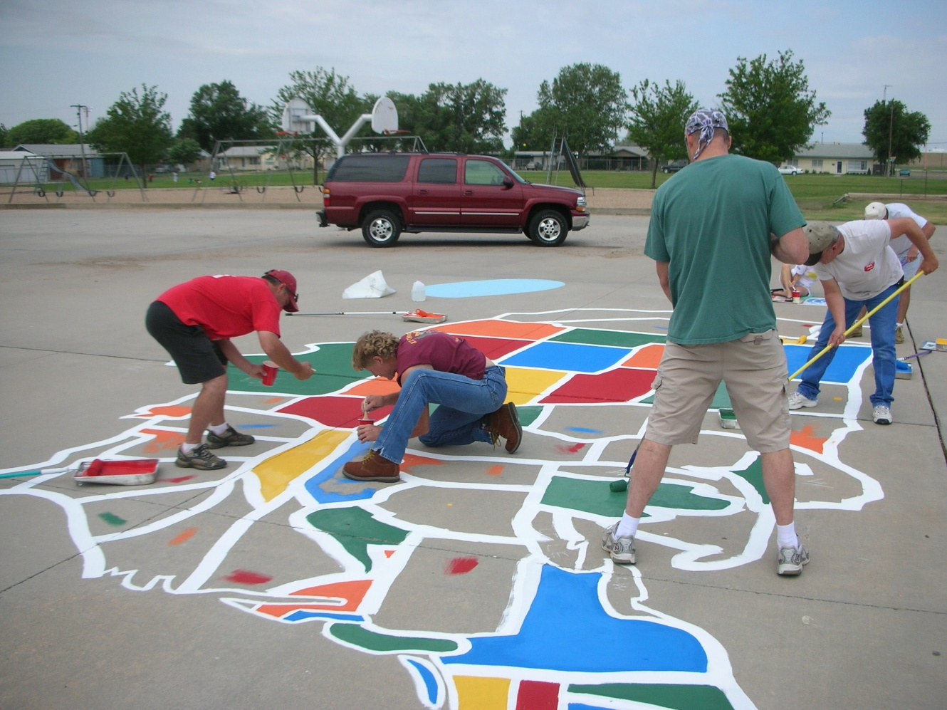
Fast
4. Color in the states.

Slide 13
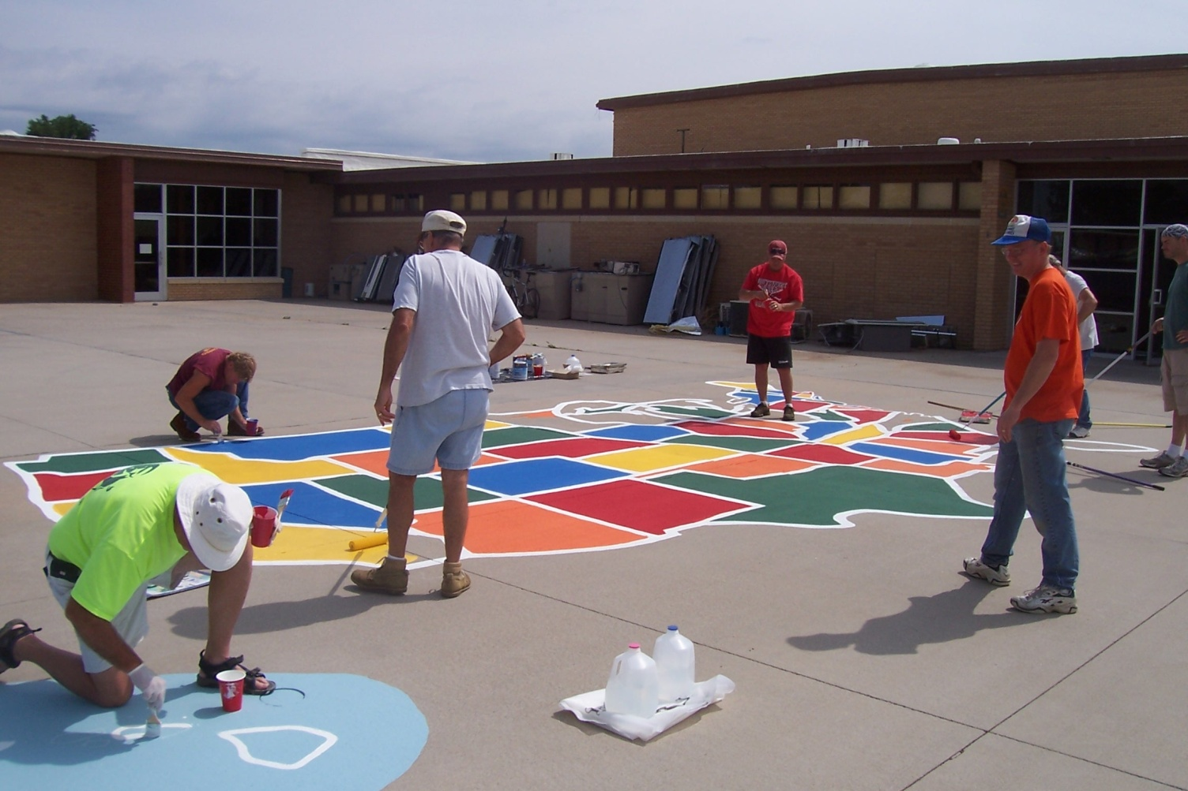
Fast
5. Touch up the details.

Slide 14
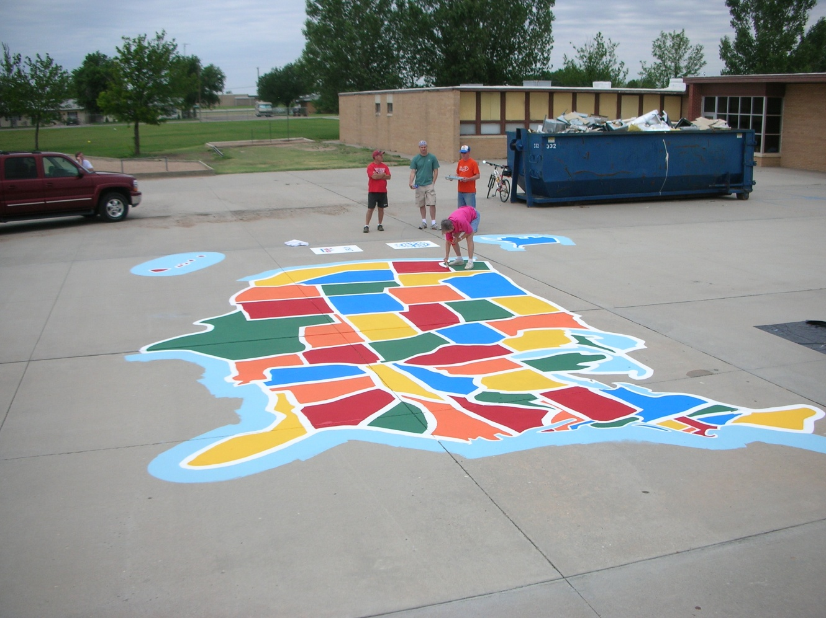
Fast
6. Stand back and admire.

Slide 15
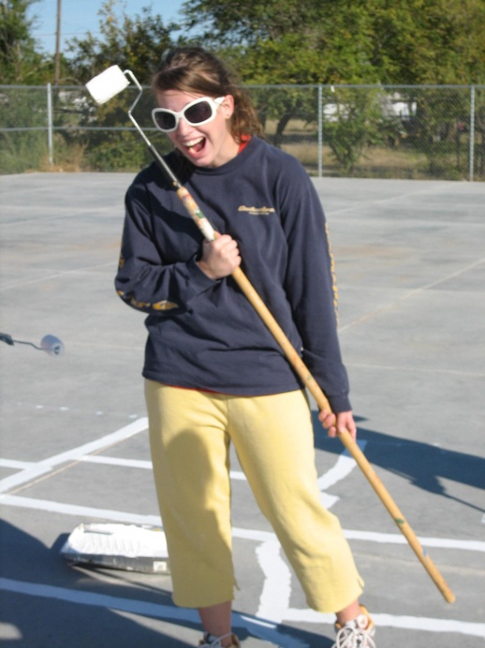
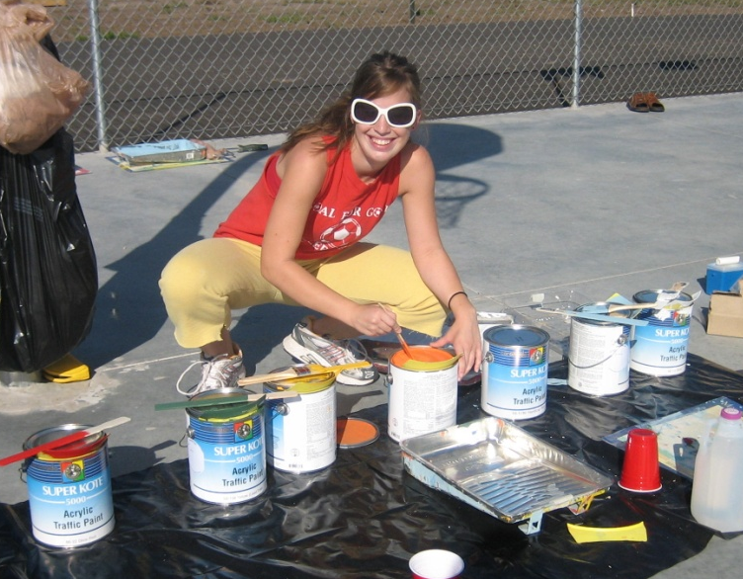
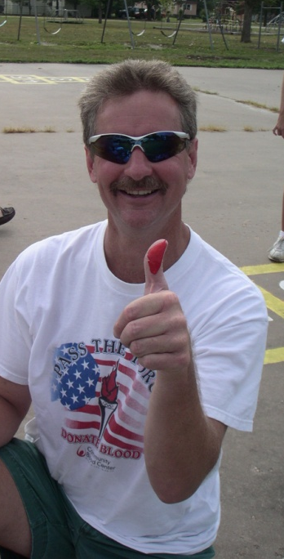
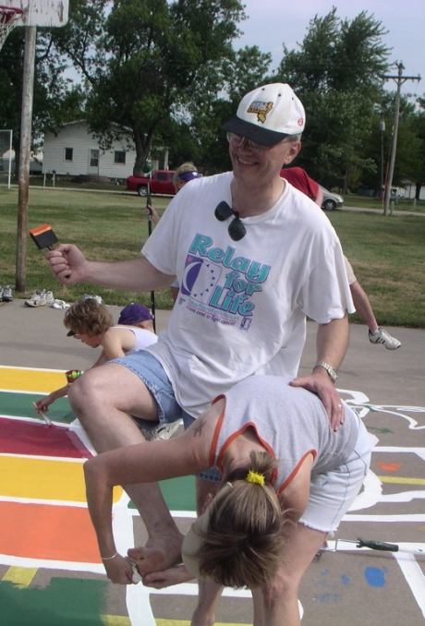
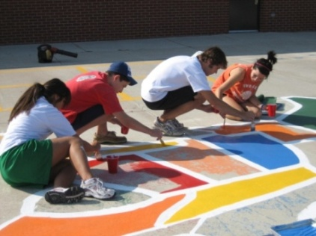
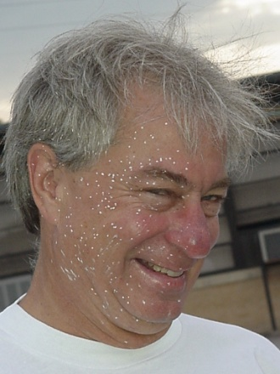
Fun

Slide 16
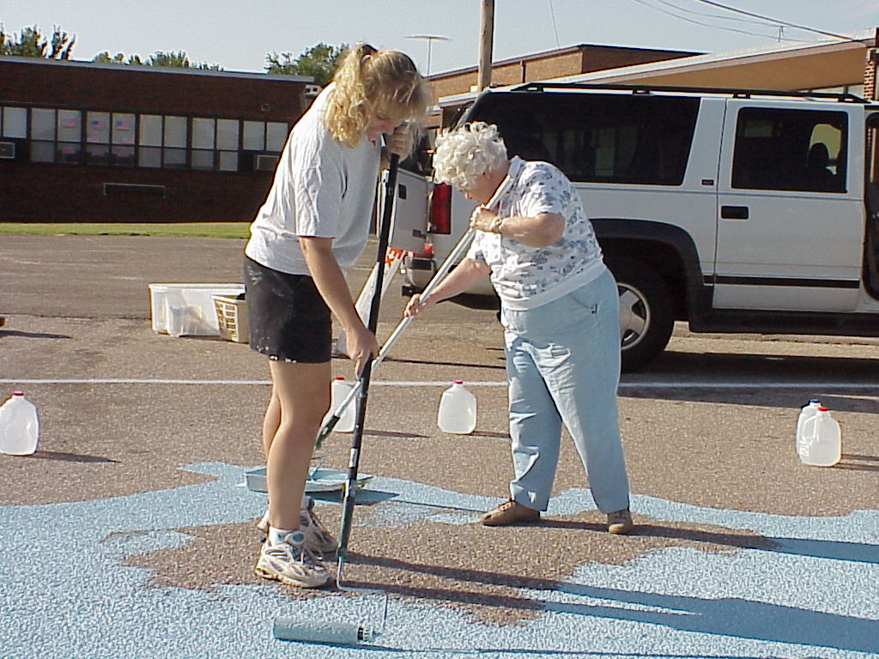
Fun for all ages

